Slide 1
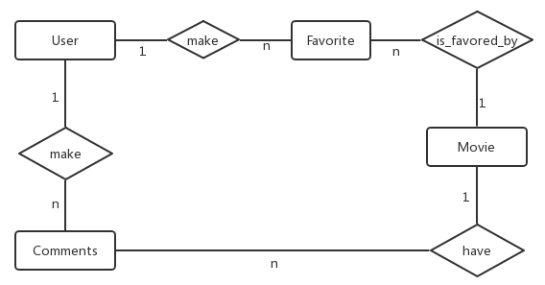
E-R Diagram
User
Field | Type
User_id | IntegerField(11)
UserName | CharField(50)
Password | IntegerField(11)
CreateTime | DateField()
Movie
Field | Type
Movie_id | IntegerField(11)
ImgURL | CharField(50)
Director | CharField(255)
Actors | CharField(255)
Category | CharField(50)
Language | CharField(50)
Nation | CharField(50)
Score | FloatField(10)
Content | TextField()
Comments
Field | Type
Comment_id | IntegerField(11)
User_id | IntegerField(11)
Movie_id | IntegerField(11)
Director | CharField(255)
Comment_content | TextField()
CreateTime | DateField()
Favorite
Field | Type
Favorite_id | IntegerField(11)
User_id | IntegerField(11)
Movie_id | IntegerField(11)
CreateTime | DateField()

Slide 2
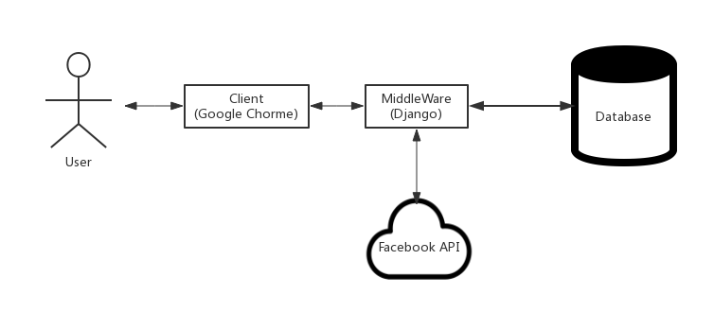
System Architecture

